Slide 1
Data Visualization
Interactive table and charts published on our website (chineseantibody.org) were generate using WPDataTable, a commercial plug-in for WordPress. Static table and charts used for this publication were generated using R.
Data Acquisition
Data Analysis
Data analysis was performed, and statistics on key aspects, such as drug targets, format and clinical status were generated using R and Python
Filtering & Validation
Source: public domains
Method: 1) Entries from search engines, company websites, biotech news feed, social media, and government databases were collected.
2) When an Application Programming Interface (API) tool is available, such as in the case of ClinicalTrials.gov, Python scripts developed in-house were used for automatic querying and retrieval.
Filtering: Entries describing preclinical or clinical development of diagnostic antibodies, polyclonal antibodies, convalescent plasma therapies, immune globulin intravenous (IGIV) therapies, small molecules, and recombinant proteins other than immunoglobin (Ig), Ig fragments, and Ig fusion proteins were removed from our collection. Studies and clinical trials without explicitly stating COVID-19 or SARS-CoV-2 as their indication or target were also eliminated. Filtering was performed manually unless an API tool was available, in which case, it was performed by the Python scripts mentioned above.
Validation: Validation of each entries we retained in our collection is performed manually, by inspecting and cross-validating using multiple sources if possible.
Update & Maintain
New data are being collected, analyzed, and published on our website on a weekly basis
Notes:
The data table containing filtered information was connected to our website, which is build using WordPress system. We used WPDatatable Plugin to integrate the data table from backend to front end of the webpage. The integration established a connection between data source and website front end that allows real-time refreshing as the data are updated. We performed data visualization and analysis on key aspect of antibody therapeutics development that we thought are most beneficial to our audience. These include visualization of the numbers of different proteins being targeted, format and clinical status of the antibodies. We also plotted the distribution of clinical status by country to visualize the progress of clinical trials in each country.

Slide 2
Step 1: Data Acquisition | Source: public domains Method: 1) Entries from search engines, company websites, biotech news feed, social media, and government databases were collected. 2) When an Application Programming Interface (API) tool is available, such as in the case of ClinicalTrials.gov, Python scripts developed in-house were used for automatic querying and retrieval.
Step 2: Filtering & Validation | Filtering: Entries describing preclinical or clinical development of diagnostic antibodies, polyclonal antibodies, convalescent plasma therapies, immune globulin intravenous (IGIV) therapies, small molecules, and recombinant proteins other than immunoglobin (Ig), Ig fragments, and Ig fusion proteins were removed from our collection. Studies and clinical trials without explicitly stating COVID-19 or SARS-CoV-2 as their indication or target were also eliminated. Filtering was performed manually unless an API tool was available, in which case, it was performed by the Python scripts mentioned above. Validation: Validation of each entries we retained in our collection is performed manually, by inspecting and cross-validating using multiple sources if possible.
Step 3: Data Analysis | Data analysis was performed, and statistics on key aspects, such as drug targets, format and clinical status were generated using R and Python
Step 4: Data Visualization | Interactive table and charts published on our website (chineseantibody.org) were generate using WPDataTable, a commercial plug-in for WordPress. Static table and charts used for this publication were generated using R.
Step 5: Update and Maintenance | New data are being collected, analyzed, and published on our website on a weekly basis

Slide 3
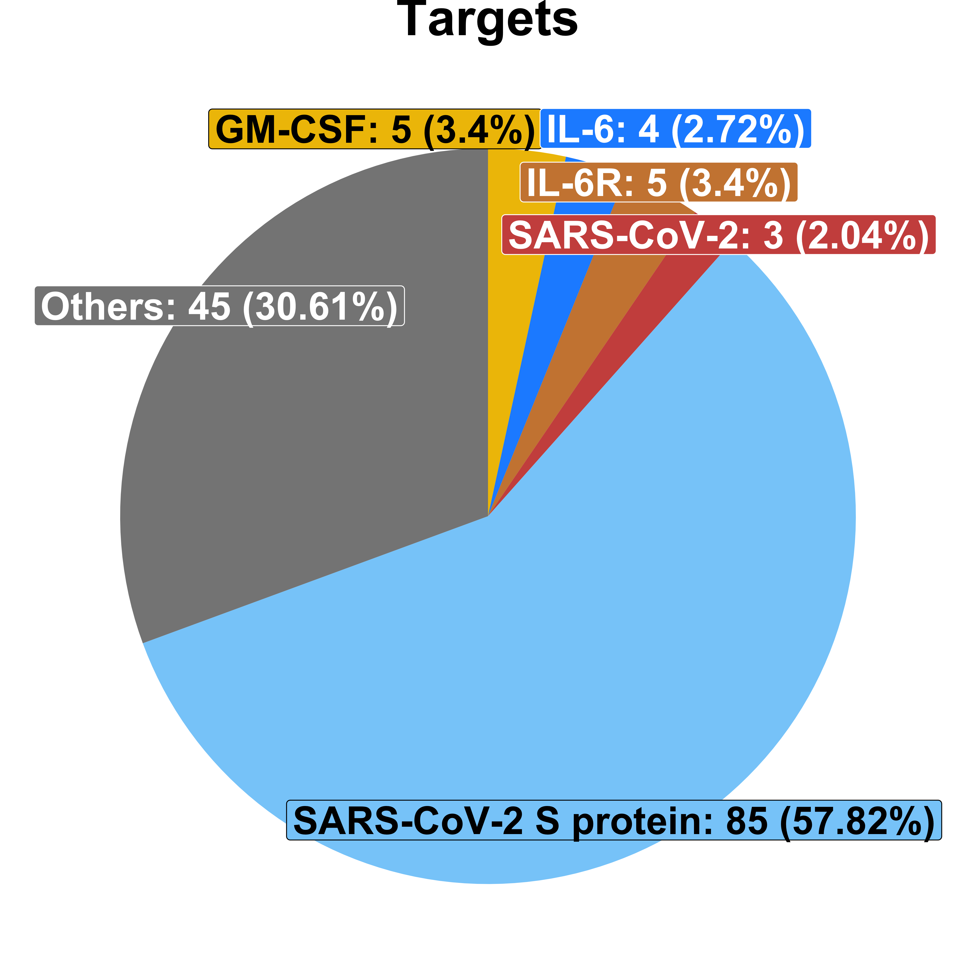
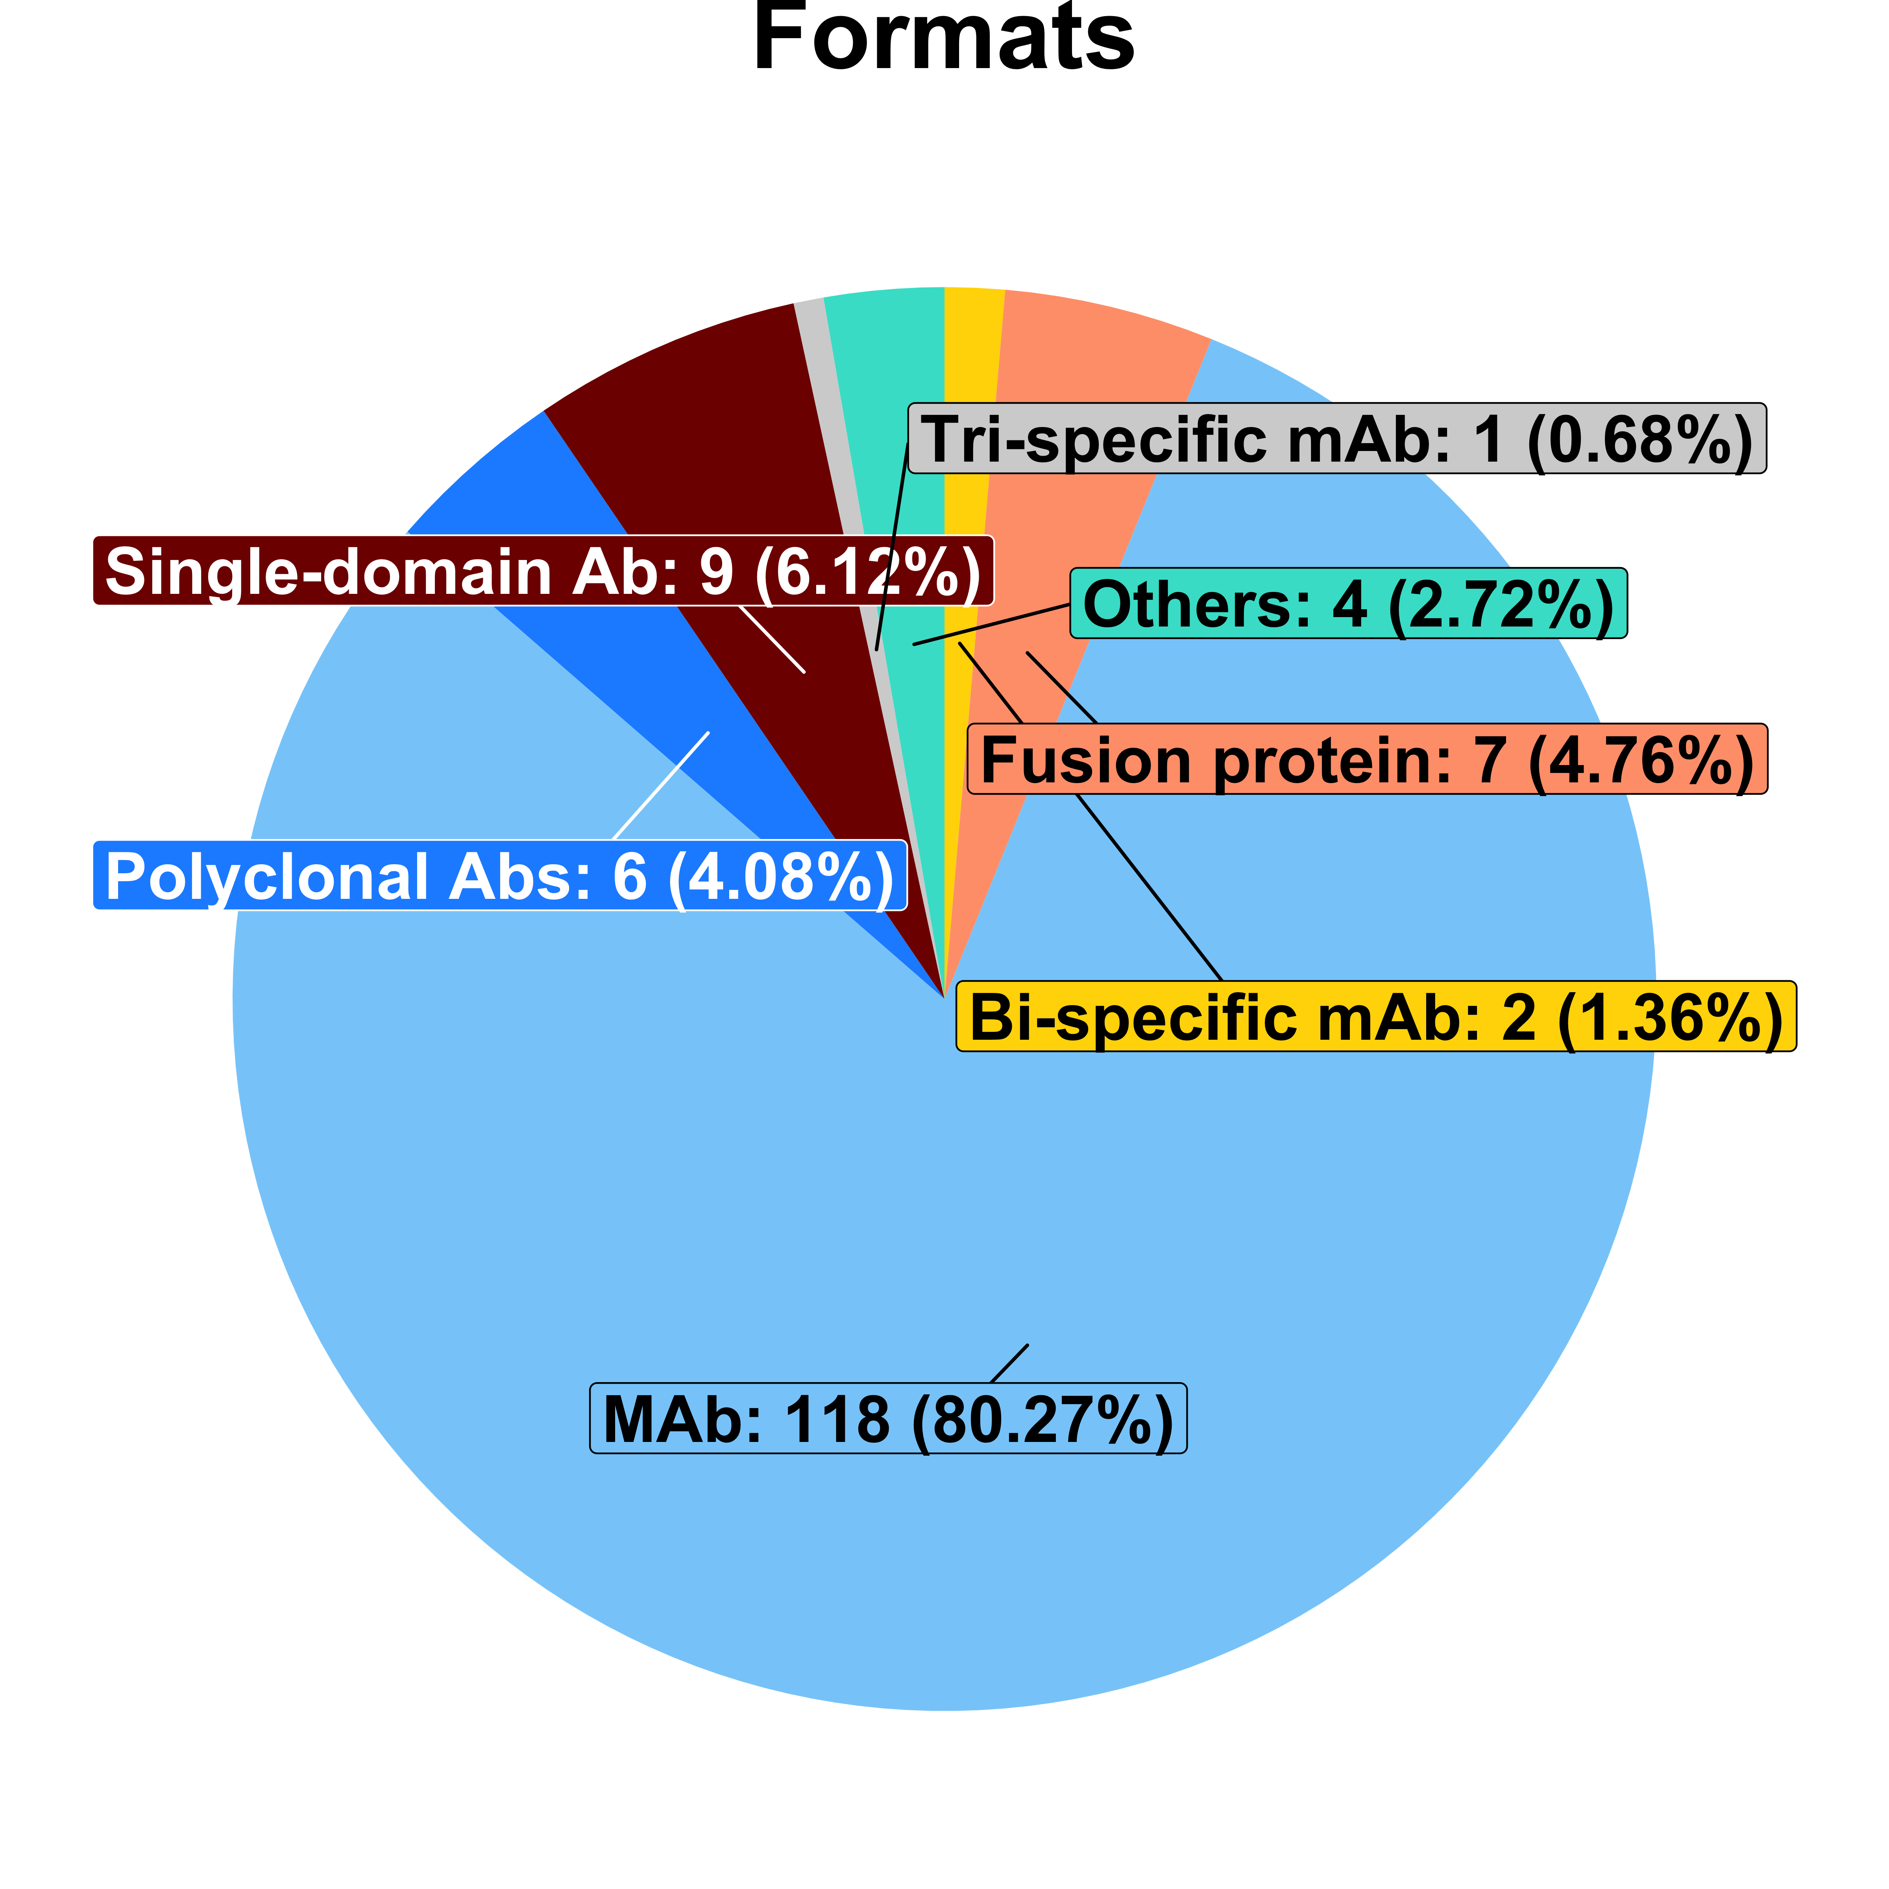
A.
B.
A.
B.

Slide 4
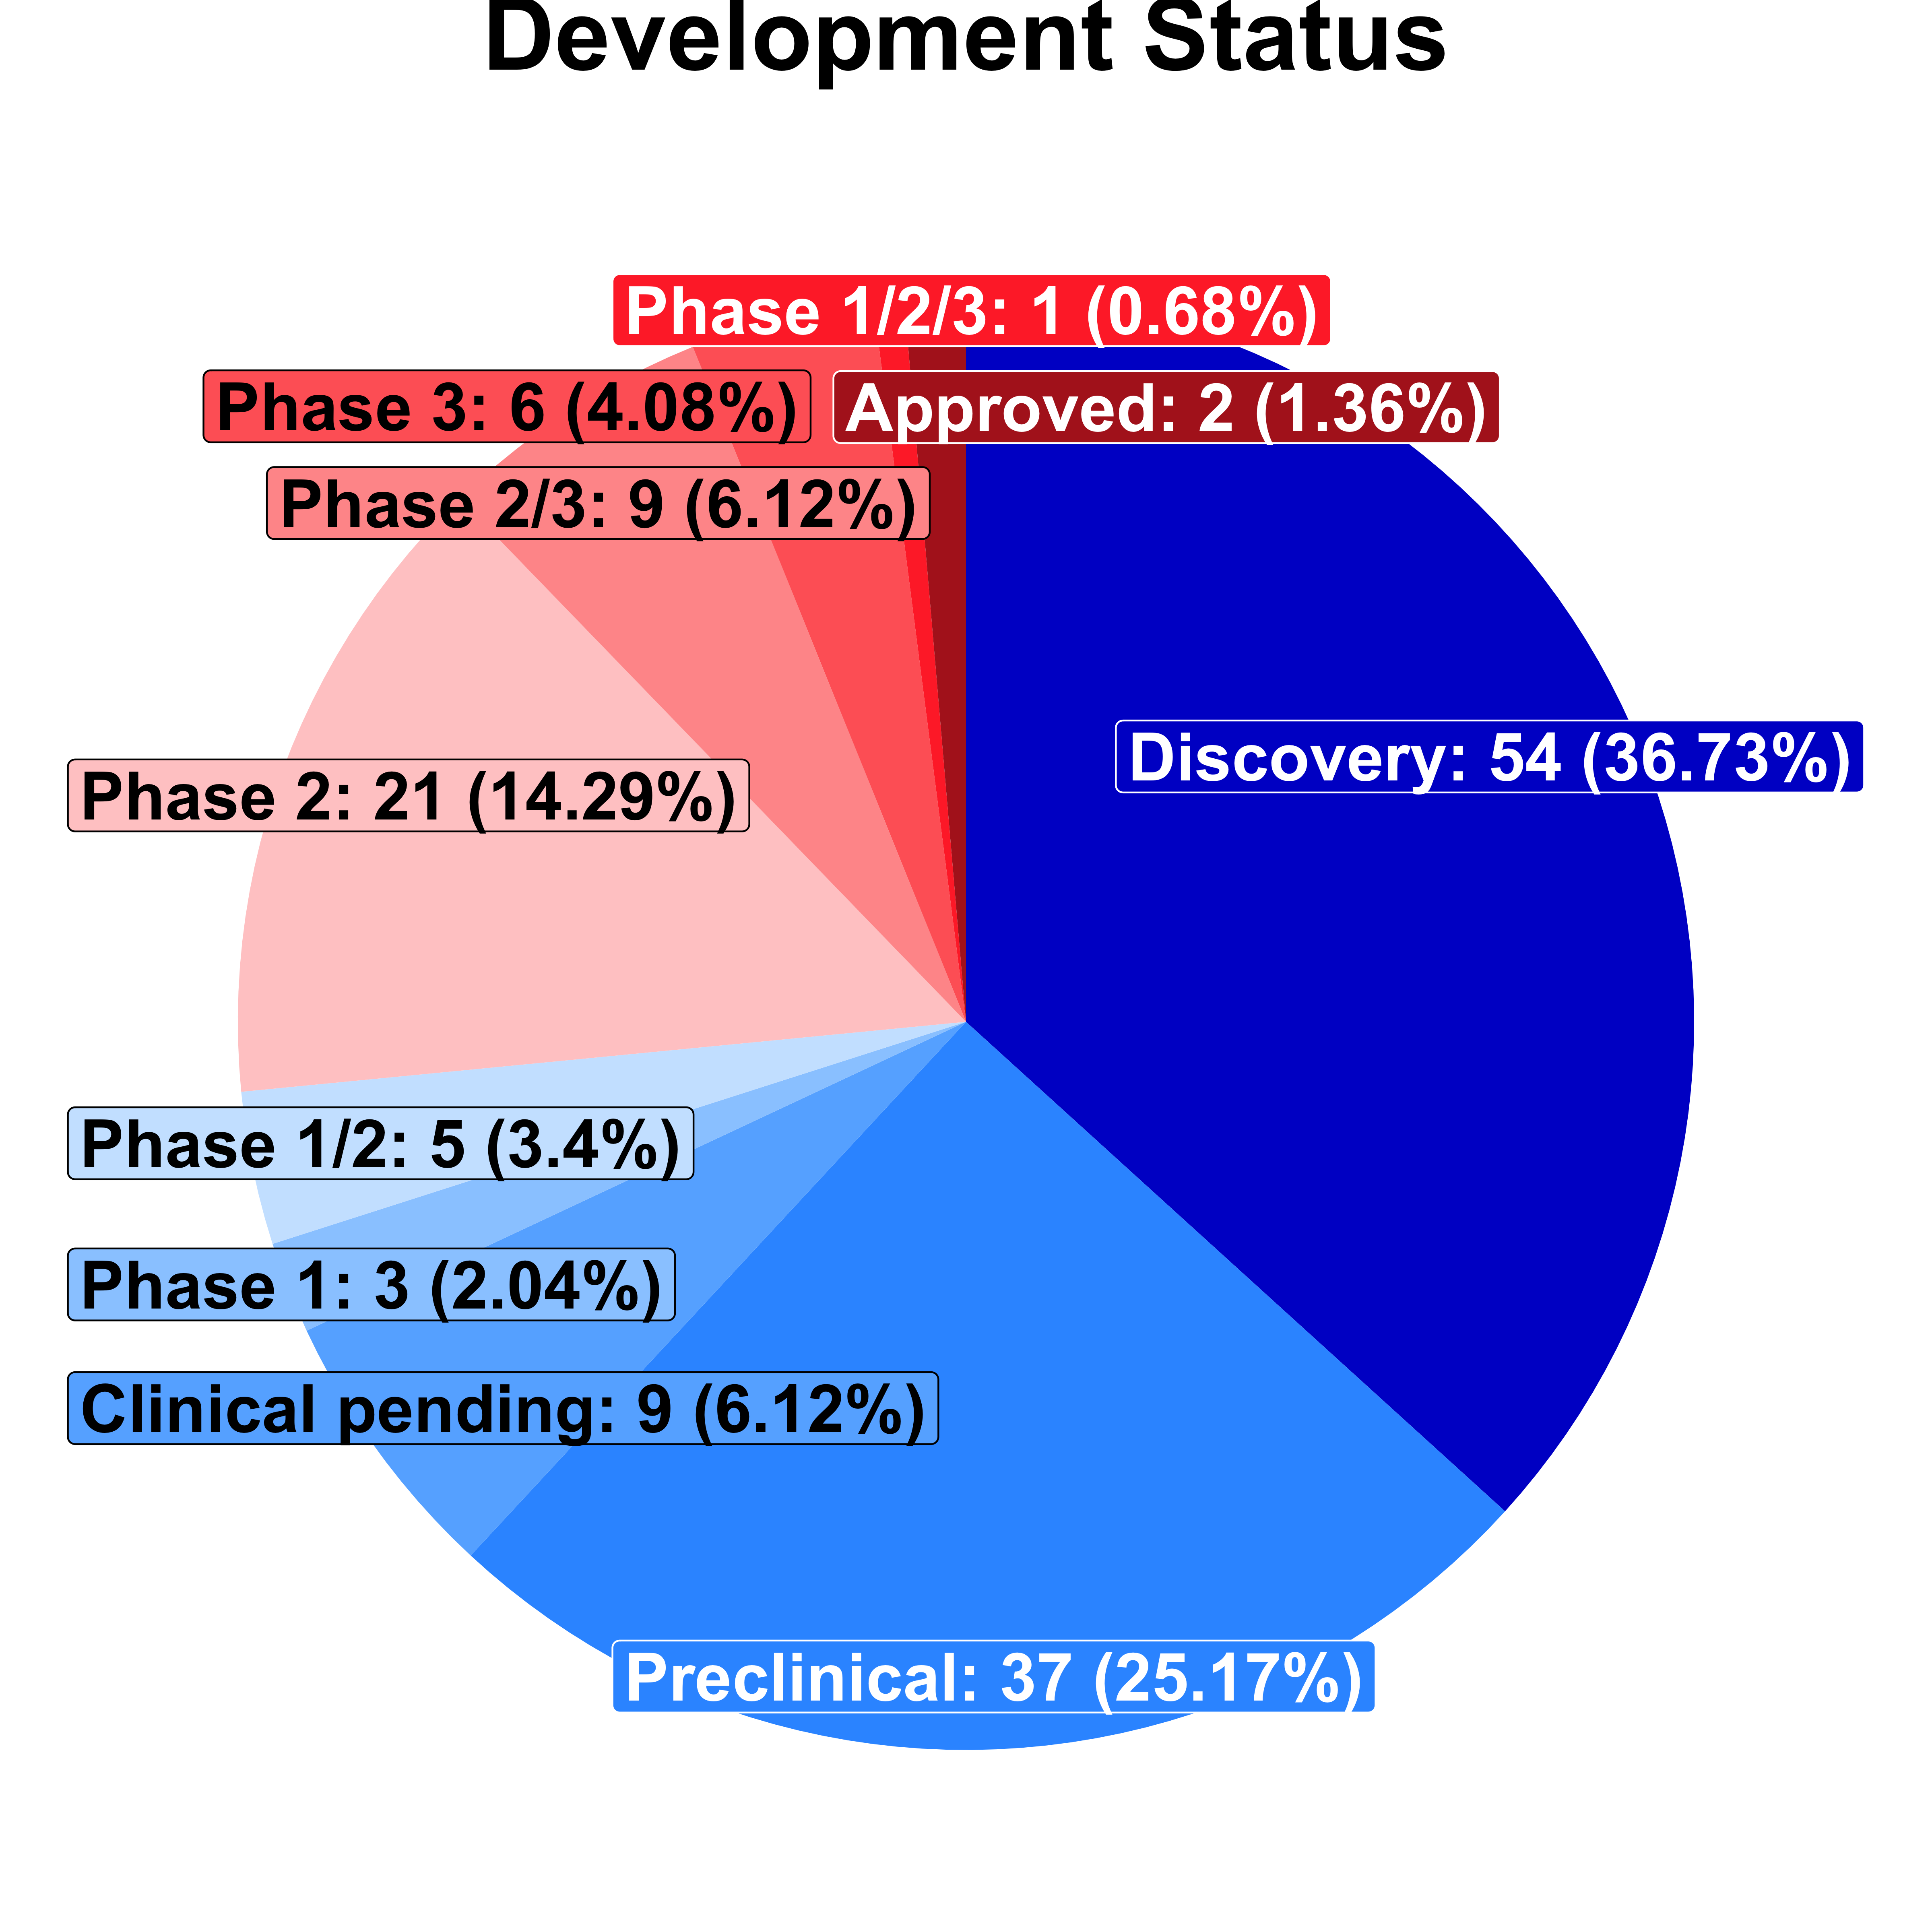
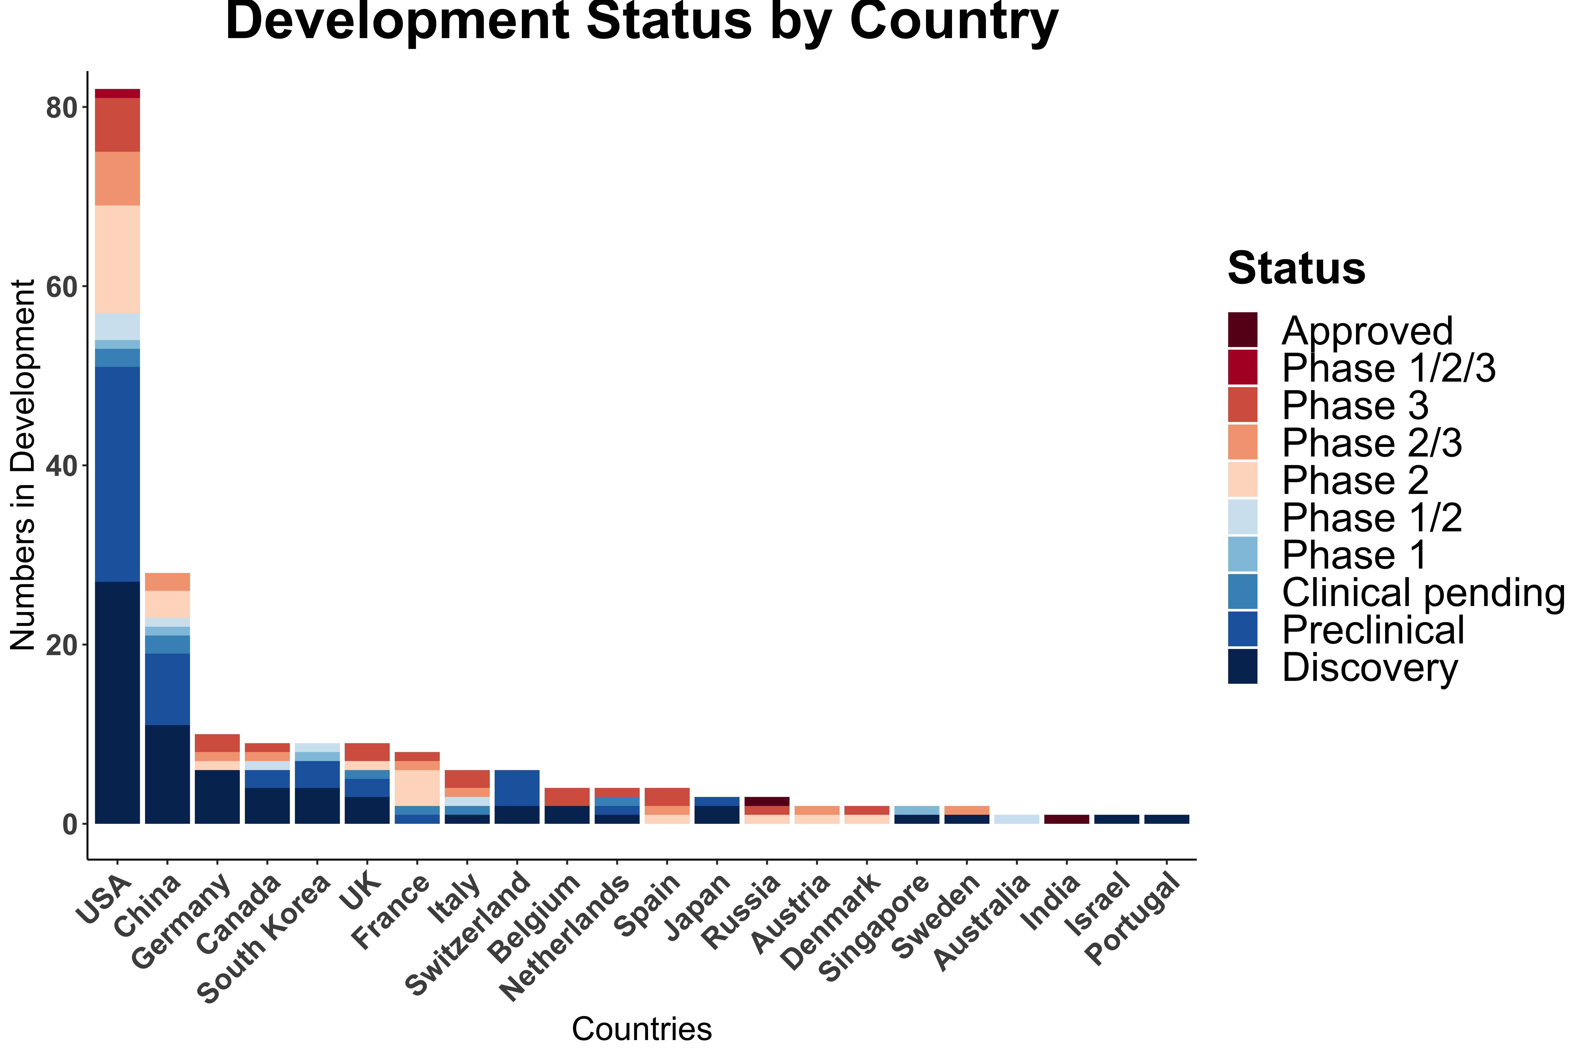
A.
B.
Development Status
Development Status by Country
Notes:
We want to emphasize that there are many multi-national collaborations in developing COVID-19 therapeutic antibodies. Our method is to attribute +1 for each country that participated in the collaboration. For example, if an antibody is jointly developed by institutions/companies in the USA,Germany and China, then each country’s count will add 1.
Figure 3: Clinical Trial status(ongoing)

